Slide 1
Automated Demand Forecasting :
Xpert Modeller
www.applexus.com

Slide 2
Demand Forecasting
Objective : Forecast product demand for a defined time horizon, given a time series of historical order / sales data
Demand forecasting is important in supply chain planning to minimize inventory costs and for price optimization

Slide 3
Statistical Methods for Demand Forecasting
Following 12 statistical models are supported
Averaging (Simple, Weighted)
Moving (Simple, Weighted)
Exponential Smoothing (Single, Double, Triple)
Adaptive Response Rate Exponential Smoothing
ARIMA Modelling (AR, MA, ARMA, ARIMAX)

Slide 4
Module-1 : Xpert Modeller
Demand forecasting is traditionally carried out using statistical time series modelling
Building statistical models require in depth knowledge and understanding of statistical methods and processes
Given a time series of historical order / sales data, Xpert modeller automatically forecasts the order demand for a defined time horizon

Slide 5
Xpert Modeller
Xpert Modeller uses ARIMA modeling for automated forecasting
ARIMA is very popular method and widely accepted in industry
ARIMA can handle any time series with/without seasonality

Slide 6
ARIMA (p,d,q) modeling
Autoregressive AR process
Series current values depend on its own previous values
AR(p) - Current values depend on its own p-previous values
p is the order of AR process
Moving average MA process:
The current deviation from mean depends on previous deviations
MA(q) - The current deviation from mean depends on q- previous deviations
q is the order of MA process
Integrated I process:
Extract trends by subtracting with lagged series
d is the order of I process

Slide 7
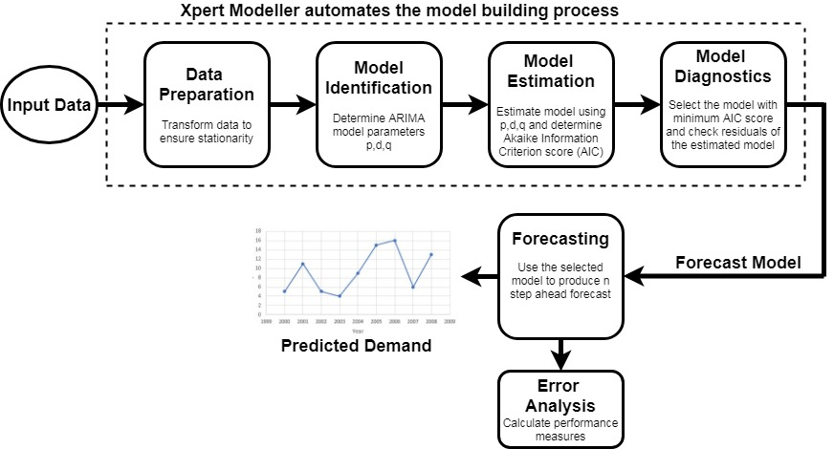
Xpert Modeller - Block Diagram

Slide 8
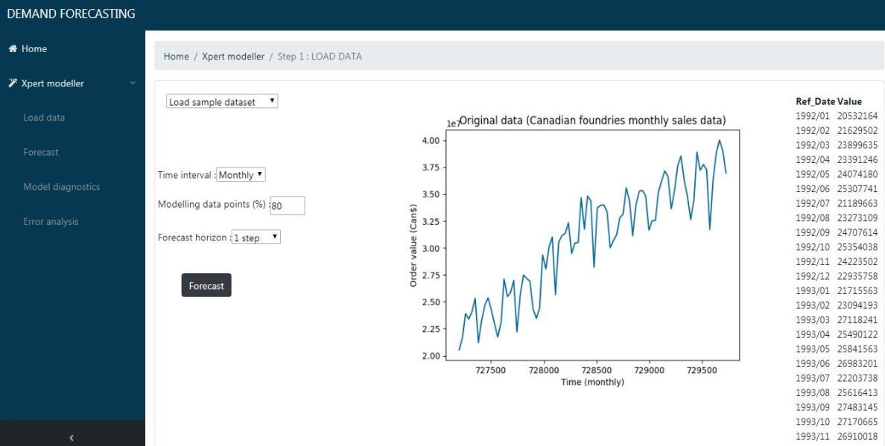
Xpert Modeller – User Interface
http://forecast.aplx.us

Slide 9
Results

Slide 10
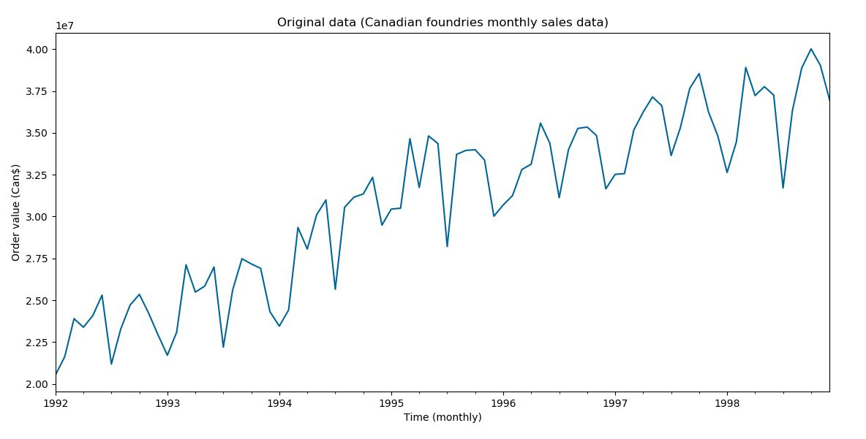
Original Data – Canadian Foundries Monthly Data

Slide 11
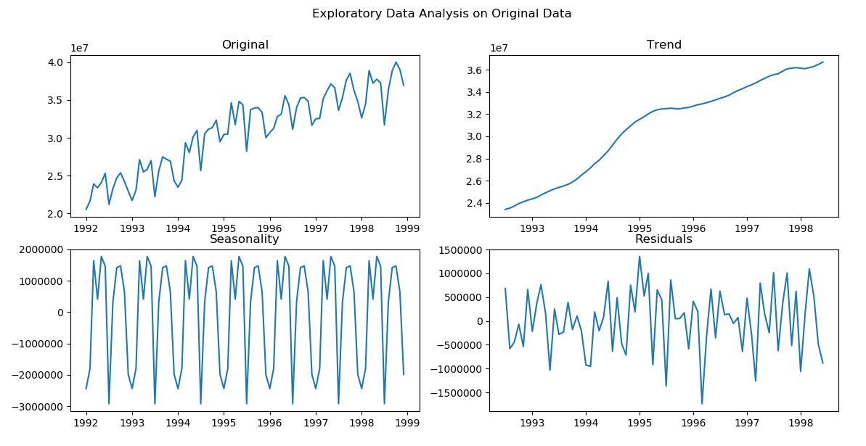
Exploratory Data Analysis

Slide 12
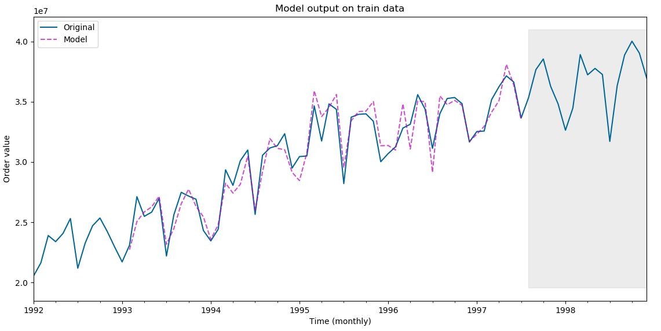
Model Output on Train Data
Train data
Validation data

Slide 13
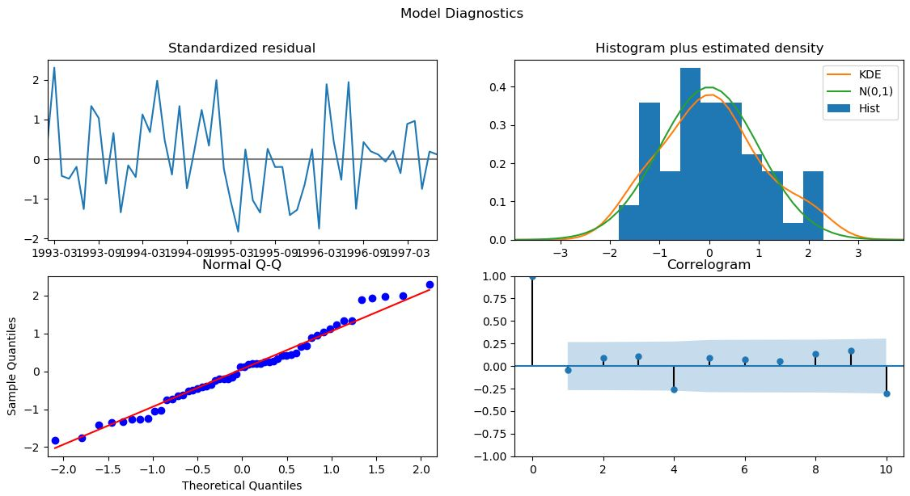
Model Diagnostics

Slide 14
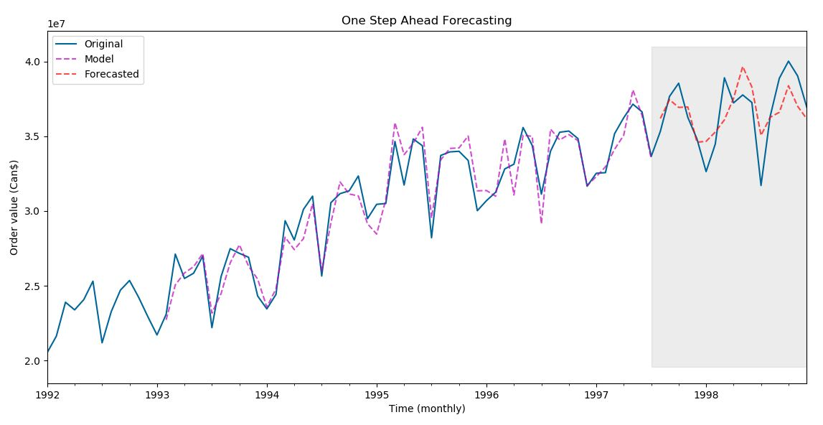
One Step Ahead Forecasting
Train data
Validation data
Train data
Validation data

Slide 15
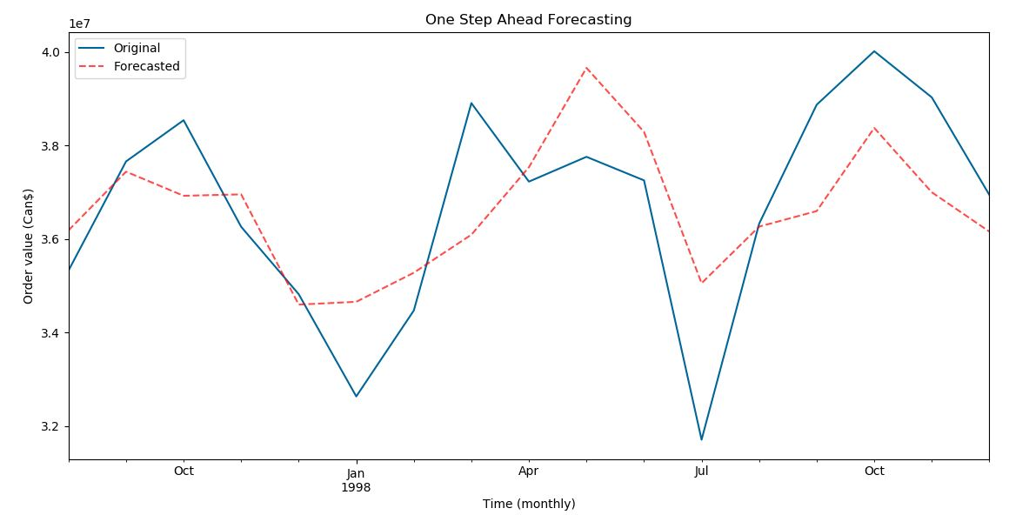
One Step Ahead Forecasting

Slide 16
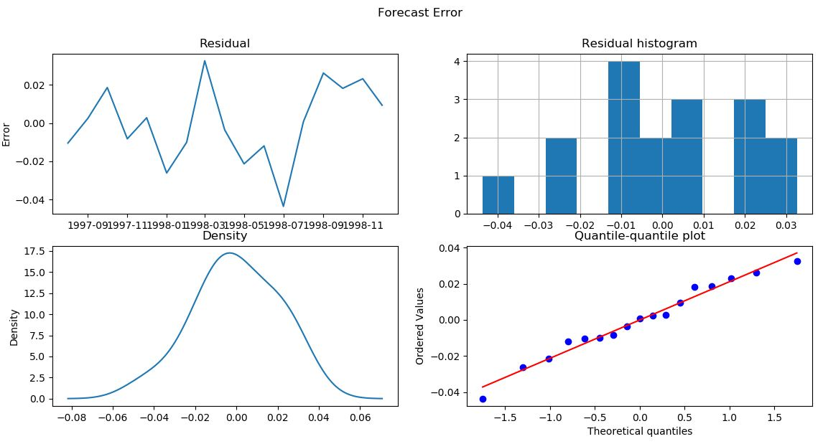
Forecast Errors

Slide 17
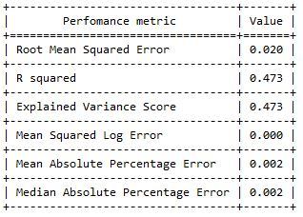
Perfomance Measures

Slide 18
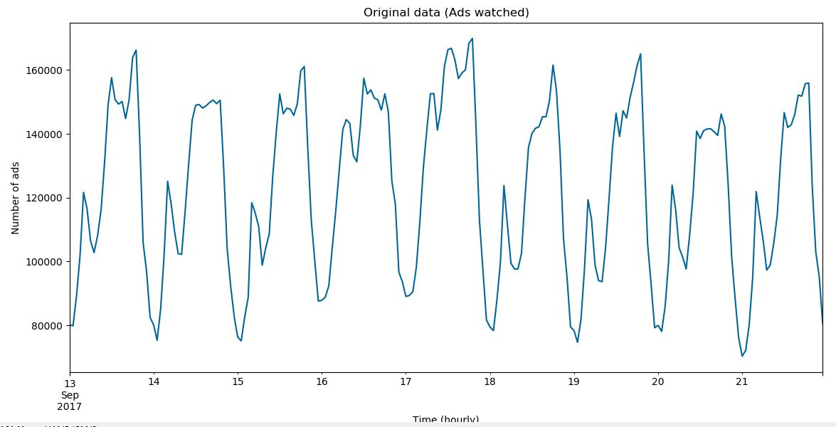
Original Data – Ads Watched Hourly Data

Slide 19
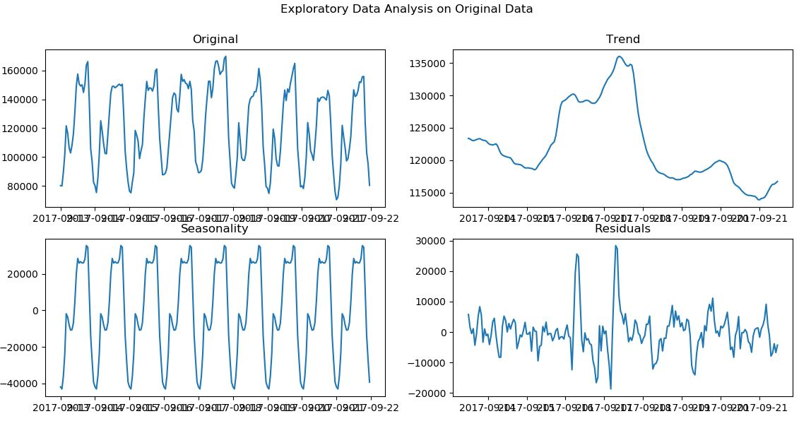
Exploratory Data Analysis

Slide 20
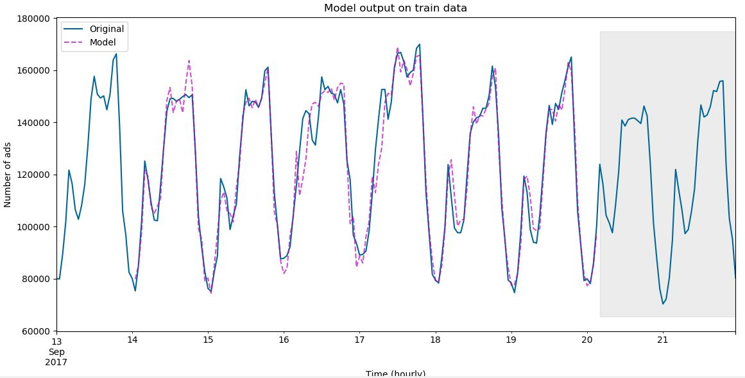
Model Output on Train Data
Train data
Validation data
Validation data

Slide 21
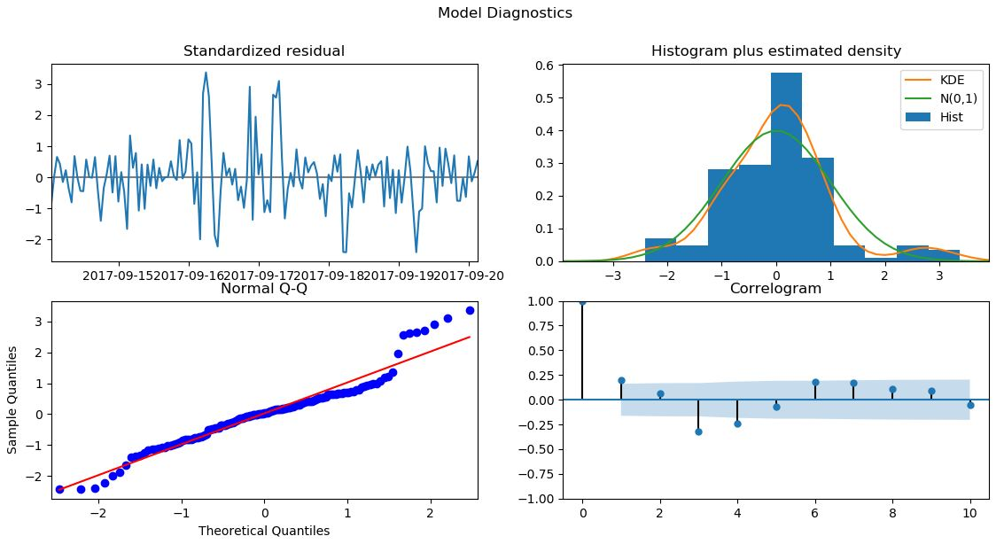
Model Diagnostics

Slide 22
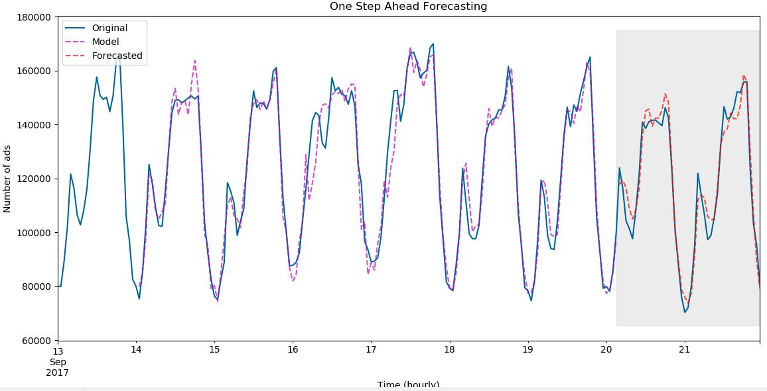
One Step Ahead Forecasting

Slide 23
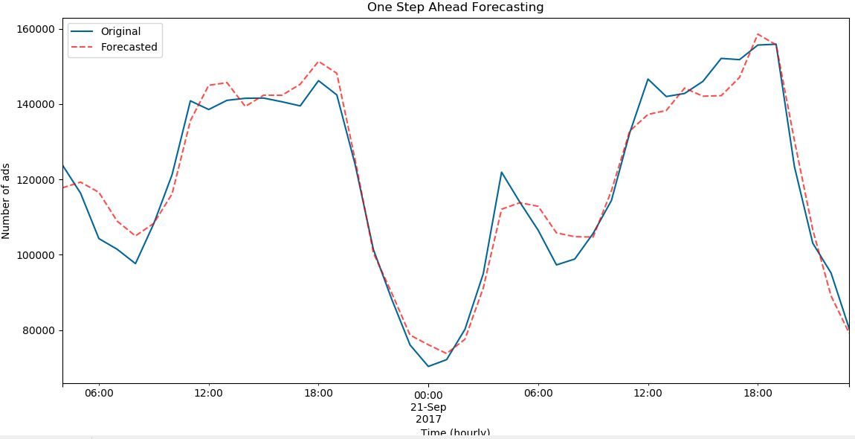
One Step Ahead Forecasting

Slide 24
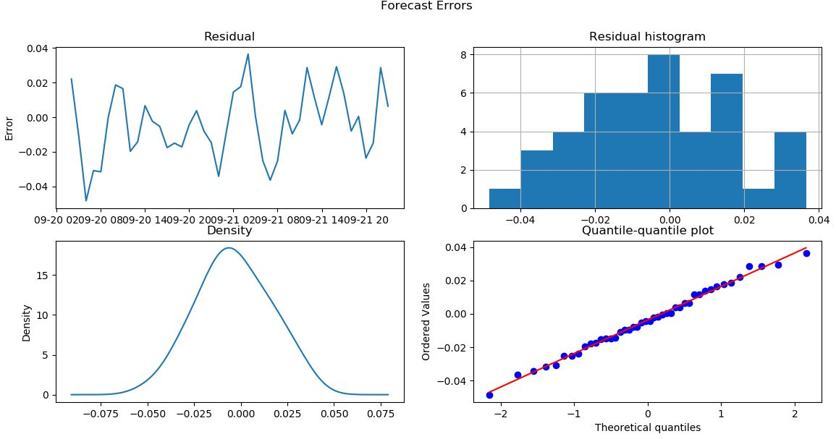
Forecast Errors

Slide 25
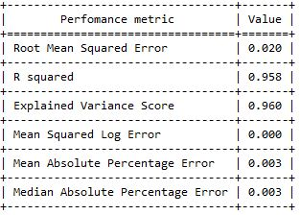
Perfomance Measures

Slide 26
Next Steps
Module-1 : Xpert Modeller
Automatically builds statistical model and forecast demand
Module-2 : Advanced Modeller
Allows user to build different statistical forecasting models
Multiple data transformation methods
User defined model identification
Different performance measures
Module-3 : Machine Learning Modeller
Employs different machine learning methods to build prediction
Prediction using multiple features data
Module-4 : Forecast Intermittent Demand

Slide 27
Your Phone #
contact@applexus.com

